Slide 1
Railway management system
Submitted To:- Dr. Vikas Solanki

Slide 2
Team members
Team Leader : Ayush Singla (2010991512)
Name | Role
Aryan Dev Shourie (2010991496) | Research, database queries and E-R diagram
Ayush Singla (2010991512) | Normalisation, database queries and triggers
Bhavesh Vaidya (2010991517) | Research and database queries
Bhavika Aggarwal (2010991519) | Normalisation, Database queries and research.

Slide 3
Introduction
The Railway Reservation System facilitates the passengers to enquire about the trains available on the basis of source and destination, Booking and Cancellation of tickets, enquire about the status of the booked ticket, etc. The aim of case study is to design and develop a database maintaining the records of different trains, train status, and passengers.

Slide 4
objective
This project is about creating a database about the Railway Management System. The railway management system facilitates the passengers to enquire about the trains available on the basis of source and destination, booking and cancellation of tickets, enquire about the status of the booked ticket, etc. The aim of case study is to design and develop a database maintaining the records of different trains, stations, and passengers. The record of the train includes its number, name, days on which it is available etc. Passengers can book their tickets for the train in which seats are available. For this, passengers have to provide the desired train number and the date for which ticket is to be booked. Before booking a ticket for a passenger, the validity of train number and booking date is checked. Once the train number and booking date are validated, it is checked whether the seat is available. If yes, the ticket is booked with confirm status and corresponding ticket no. is generated which is stored along with other details of the passenger. The ticket once booked can be cancelled at any time. For this, the passenger has to provide the ticket ID (the unique key). The ticket ID is searched and the corresponding record is deleted.

Slide 5
Operations possible
Booking Tickets
Cancellation Of Tickets
Queries about train
1. Train number
2. Number of seats available
3. Running days, etc
Queries about station
1. Station code
2. Staff
3. Availability of Wi-fi and food, etc
`Queries about passengers
1. Name
2. Age
3. Email-Id
4. Contact- information, etc

Slide 6
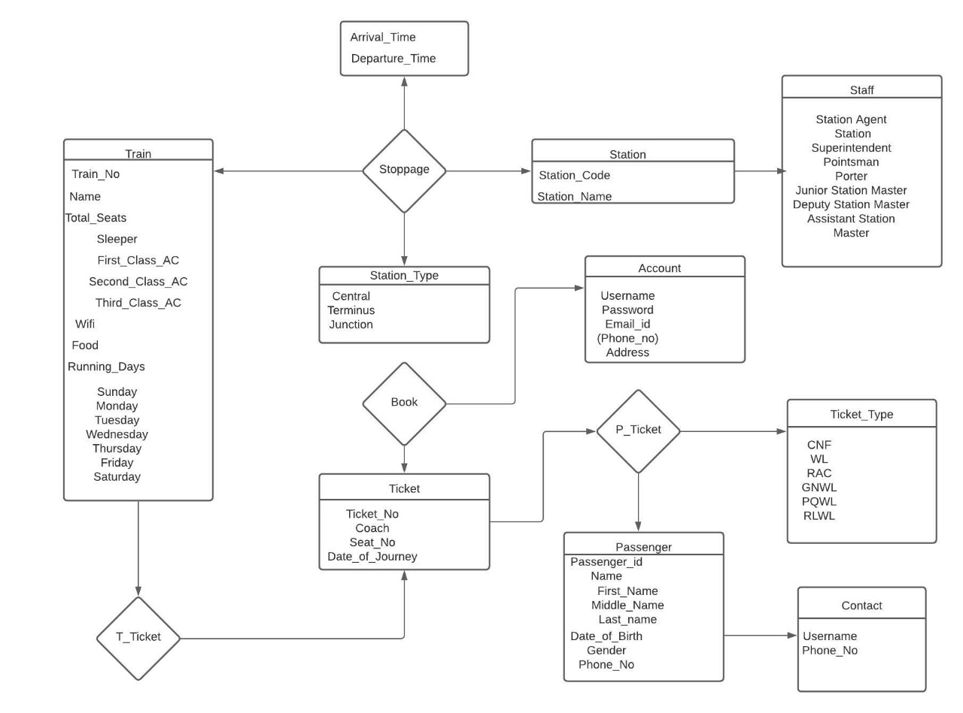
ER Diagram

Slide 7
Physical schema…

Slide 8
Attribute | Datatype |  | Constraint
Train_No | INT |  | PRIMARY KEY, NOT NULL
Name | VARCHAR |  | NOT NULL
Seat_Sleeper | INT |  | NOT NULL
Seat_First_Class_AC | INT |  | NOT NULL
Seat_Second_Class_AC | INT |  | NOT NULL
Seat_Third_Class_AC | INT |  | NOT NULL
Wifi | CHAR |  | NOT NULL
Food | CHAR |  | NOT NULL
Run_On_Sunday | CHAR |  | NOT NULL
Run_On_Monday | CHAR |  | NOT NULL
Run_On_Tuesday | CHAR |  | NOT NULL
Run_On_Wednesday | CHAR |  | NOT NULL
Run_On_Thursday | CHAR |  | NOT NULL
Run_On_Friday | CHAR |  | NOT NULL
Run_On_Saturday | CHAR |  | NOT NULL

Slide 9
Account_Table
Station
column | type | constraint
username | VARCHAR(15) | Primary key
Pass_word | VARCHAR(20) | Not null
Email_id | VARCHAR(35) | Not null
address | VARCHAR(50) | -
Column | type | Constraint
Station_code | Char(5) | Primary key
Station_name | Varchar(25) | Not null
Station_type
Contact
Column | type | Constraint
Central | Varchar(25) | Not null
Terminus | Varchar(25) | Not null
junction | Varchar(25) | Not null
Column | type | Constraint
Username | Varchar(25) | Primary key
Phone_no | Char(10) | Not null

Slide 10
Passenger
Column | Constraint | Type
PASSENGER_ID | Primary key | NUMBER
USERNAME | NOT NULL | VARCHAR2(50)
FIRST_NAME | NOT NULL | VARCHAR2(50)
MIDDLE_NAME | NOT NULL | VARCHAR2(50)
LAST_NAME | NOT NULL | VARCHAR2(50)
DATE_OF_BIRTH | NOT NULL | NUMBER
GENDER | NOT NULL | VARCHAR2(50)
PHONE_NO | NOT NULL | NUMBER

Slide 11
triggers
A trigger has been created which is invoked each time a ticket is cancelled. The trigger helps in increasing the number of seats in a coach after cancellation.
delimiter //
create trigger cancellation
before delete on ticket
for each row
BEGIN
set @trainno=old.train_no;
set @ticketno=old.ticket_no;
SET @class = (SELECT p.class
FROM PASSENGER p
WHERE p.ticket_no = @ticketno);
if @class='first class ac' then
UPDATE Train set Seat_First_Class_AC = Seat_First_Class_AC+1 WHERE Train_No =
@trainno ;
elseif @class='sleeper' then
UPDATE Train set Seat_Sleeper = Seat_Sleeper+1 WHERE Train_No = @trainno ;
elseif @class='second class ac' then
UPDATE Train set Seat_Second_Class_AC = Seat_Second_Class_AC+1 WHERE
Train_No = @trainno ;
elseif @class='third class ac' then
UPDATE Train set Third_Class_AC = Seat_Third_Class_AC+1 WHERE Train_No =
@trainno ;
end if;
END//
delimiter ;

Slide 12
normalisation
FIRST NORMAL FORM:As per the rule of first normal form, an attribute (column) of a table cannot hold multiple values. It should hold only atomic values. The above schema is in 1NF since all the attributes are atomic and not multivalued. Since a passenger could have multiple phone numbers, it would violate the 1NF rules. Hence we have created a separate table called contact to handle this.
SECOND NORMAL FORM:A table is said to be in 2NF if both the following conditions hold:
-Table is in 1NF (First normal form)
-No non-prime attribute is dependent on the proper subset of any candidate key of table.
If we consider ticket_no and first_name as the candidate key, then date_of_birth would depend only on the name and it would violate the 2NF. So, to remove this we have created two tables which are train and passenger.
THIRD NORMAL FORM:A table design is said to be in 3NF if both the following conditions hold:
-Table must be in 2NF.
-Transitive functional dependency of non-prime attribute on any super key should be removed.
Our schema follows the above rules and hence is in 3NF.

Slide 13
queries
Query 1: Find the phone number of the user whose email ID is ajitesh@pes.edu
SELECT Phone_no FROM Contact WHERE username IN (SELECT Username FROM account WHERE Email_id=’ajitesh@pes.edu’);
Query 2: Find the time at which the train leaves the New Delhi Station.
CREATE VIEW f(Departure_time) AS
SELECT Departure_time
FROM Stoppage
WHERE Station_Code IN (SELECT Station_code FROM station WHERE Station_Name=’New Delhi’);
SELECT * FROM f;
SELECT MAX(Departure_time) FROM f;

Slide 14
Conclusion
This Database is helpful for the applications which facilitate passengers to book the train tickets and check the details of trains and their status from their place itself. It avoids inconveniences of going to the Railway Station for each and every query they get. Our system can successfully give information on any train, find trains running between two stations, book tickets and cancel tickets.

Slide 15
Future scope
We can further create a front-end using web-development for it to be accessible.
We can even introduce the feature to track the path of the train, for it to become much more user- friendly.
More features like ordering food at stoppages and all can be introduced.
Email verifications can be introduced.
A payment- gateway also needs to be introduced.

Slide 16
thankyou

